Slide 1
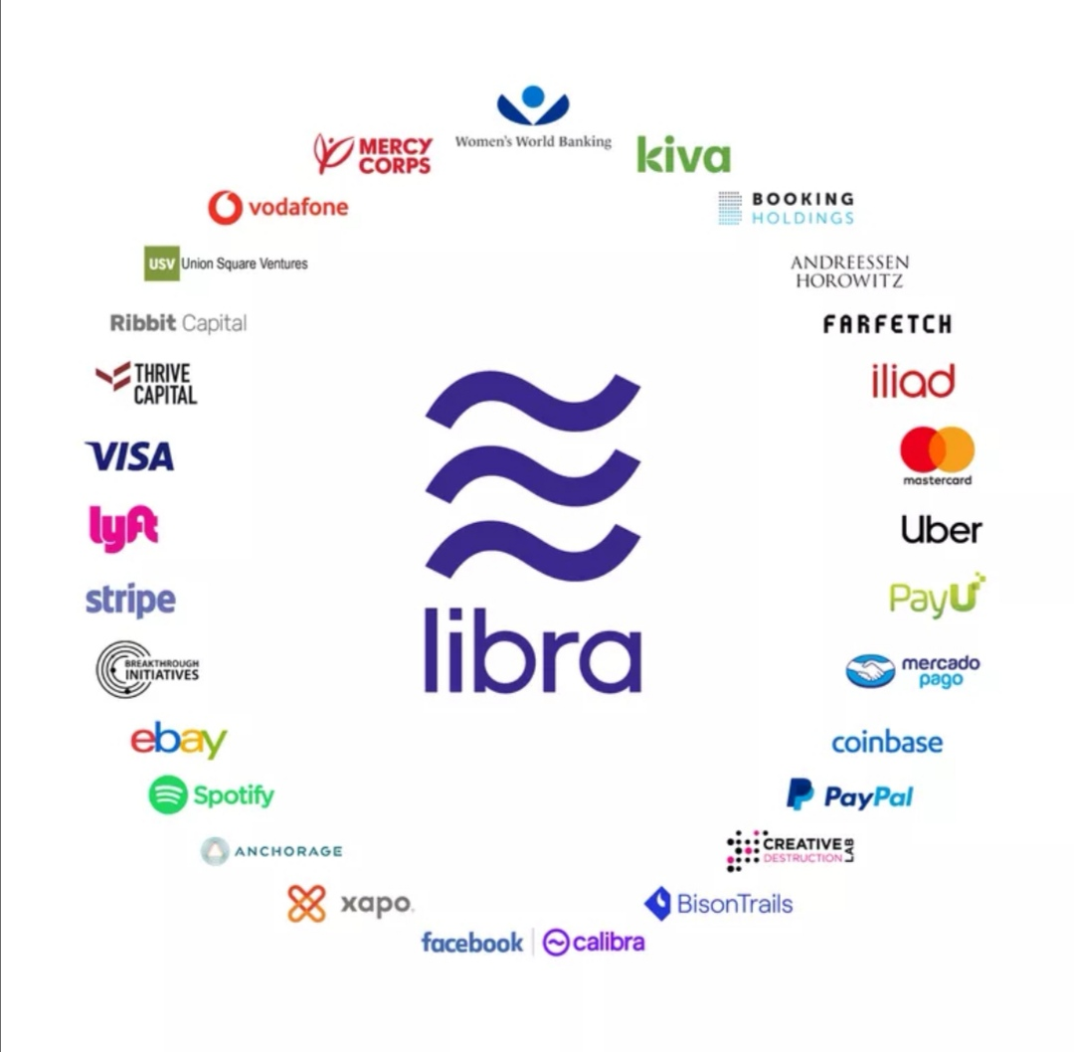

The Libra on Blockchain -- A platform for Facebook’s Libra coin (and more)
LING Zong, Ph. D.
Senior Software Engineer / Scientist
IBM Almaden Research Center
San Jose, California, U.S.A.
Notes:
https://developers.libra.org/docs/assets/papers/the-libra-blockchain.pdf

Slide 2

What is Libra?
Recently Facebook has outlined the objectives of its new cryptocurrency called Libra. Facebook has been developing this cryptocurrency for more than a year.
Libra is designed to allow payment processing around the internet globally. It will incorporate 1.7 billion people all around the world who doesn’t have a bank account.
On June 18, 2019, Facebook announced Libra. It is a virtual currency, or cryptocurrency, though some people don’t agree with that definition.
In Facebook’s vision, it should become a global currency for billions of people, especially those in developing countries who have no access to banks or financial services. In other words, Digital money which you can transfer to other people or simply use to buy stuff.
A bunch of Silicon Valley hotshots are also on-board with the plan.
Libra will be governed by the Libra Association, a Swiss group including 28 members – among which Facebook subsidiary Calibra, Uber, PayPal, Mastercard, Visa, Spotify, and many other household names in technology and finance.
Notes:
https://www.wired.co.uk/article/facebook-libra-cryptocurrency-explained

Slide 3
The Method
The Libra protocol allows a set of replicas—referred to as validators—from different authorities to jointly maintain a database of programmable resources.
There’s no mincing of words here—the system will be controlled by a set of authorities in a top-down fashion. However, note that it says the database is for “programmable resources” rather than just digital currency.
These resources are owned by different user accounts authenticated by public key cryptography and adhere to custom rules specified by the developers of these resources.
The use of generic words such as “resources” makes me suspect that this is for far more than just a stablecoin.
Transactions are based on predefined and, in future versions, user-defined smart contracts in a new programming language called Move. We use Move to define the core mechanisms of the blockchain, such as the currency and validator membership.
Use of a custom-built smart contracting language will result in a lot of questions around how feature-rich the language is, and as a result, how robust the system is against adversarial contracts. There will also be questions around developer-friendliness and how well Libra can protect smart contract developers from shooting themselves in the foot.
These core mechanisms enable the creation of a unique governance mechanism that builds on the stability and reputation of existing institutions in the early days but transitions to a fully open system over time.
It sounds like the Libra Association will be a federation that can evolve with the help of a voting system and some sort of pre-existing reputation.
Notes:
https://onezero.medium.com/thoughts-on-libra-blockchain-49b8f6c26372

Slide 4
How will Libra work?
Rumors have been circulating about Libra for over a year, whether Libra is developed or managed by Facebook. Finally, we came to know Libra is a cryptocurrency managed by Libra Association. It lets the users exchange fiat currency for Libra for online transactions. To reach wider people, Libra does not need users to have a bank account. They simply need to convert money for Libra.
Libra’s white paper – a sort of technical manifesto – says that it will run on a "blockchain". Again, that is a controversial definition in some quarters, so here's a quick and rough explainer.
A blockchain is the infrastructure on which cryptocurrency payments take place. It is a digital, unchangeable record of all the payments ever happened in a given cryptocurrency.
Here’s a crucial thing: a Blockchain is decentralized. The transactions are processed and verified by a swarm of independent computers rather than by a single referee or central bank. Those independent computers are called nodes.
That decentralized structure is intended to enhance security – as there is no single entity to be hacked – and also, to guarantee that governments can’t block transactions simply by browbeating a central authority.
It is a pretty libertarian, anti-state, anti-bank tool. The first blockchain ever is, of course, the one underpinning Bitcoin, the original cryptocurrency.

Slide 5
So Libra is a cryptocurrency?
Yes, but also no.
This is where the disagreements start. The Libra blockchain is not decentralized the way the Bitcoin is.
With the Bitcoin blockchain, anyone can theoretically run a node, even if that’s expensive.
In contrast, Libra’s nodes will be only run from the servers of the Libra Association’s members – that is: Facebook, Uber, Paypal and the others.
Now, none of these companies will individually have much of a say on how transactions are processed and verified – it will be a collective effort – which is good, according to the blockchain ethos.
Still, the more libertarian cryptocurrency fans resent that Libra will be controlled by a club of mega-corporations. They also fear that the Libra Association could buckle under pressure if, for instance, a government ordered it to block a transaction.
Facebook’s official reason for this make-up is that a fully decentralized model would not be powerful or fast enough to deliver the “global financial infrastructure” Libra aspires to become.

Slide 6
Why does Libra need to be centralized?
Because of scale and speed.
Decentralization makes the system less vulnerable to hacks or shutdowns, but takes time:
Bitcoin blockchain, for instance, can only process about seven payments per second.
By comparison, the centralized Visa payment network can support up to 24,000 payments per second.
Initially, Libra should be able to handle about 1,000 transactions per second.
The white paper says that, over the next five years, Libra will shift from the current proposed model – also called “permissioned” blockchain – to a totally decentralized – or “permissionless” blockchain.
Of course, there is no guarantee that will ever happen.

Slide 7
Bitcoin is really volatile, isn't that a problem?
Absolutely.
Over the course of 2017, the price of Bitcoin swung between £920 and $20,000. That is great news if you are a speculator, but it’s not ideal if you want to launch a global payment network for Facebook’s 2.4 billion users. That’s why Libra has been designed as a so-called “stablecoin”.
That means the value of Libra will be tied to the value of real-world assets. Essentially, the Libra Association will store a basket of currencies (like dollars, euros and pounds) and low-risk government securities. The value of this basket will determine the value of all the Libra units in circulation. Every time a user trades cash for Libra through an exchange, that cash will be added to the Libra Association’s reserves.
At this stage, there is not much else we know about Libra. We do know that Facebook Calibra will launch a Libra wallet allowing users to exchange Libra through Messenger, WhatsApp or a standalone app. But we don’t know which businesses will accept Libra yet, thought it's probable that both Uber and Ebay will because they are both members of the Libra Association.

Slide 8
What do central banks think about Libra?
Libra doesn’t launch until 2020 but that doesn’t mean that people aren’t already fretting about the whole affair. Facebook has promised that it won’t use payment data in order to target adverts – but people don’t trust Facebook, for notorious reasons.
And regulators are also frowning upon the move. France has underlined that only governments can mint money, and has warned against Libra’s potentially nefarious uses. The bank of England said that Libra will have to meet very high financial standards to be allowed in the UK.
And, of course, lawmakers in both the US and the EU are concerned about Facebook’s expansion to the financial domain. For a company which is increasingly depicted as an oversized, unaccountable, arrogant monopoly, is launching a currency really the best way to avoid scrutiny?
We’ll find out in 2020.

Slide 9
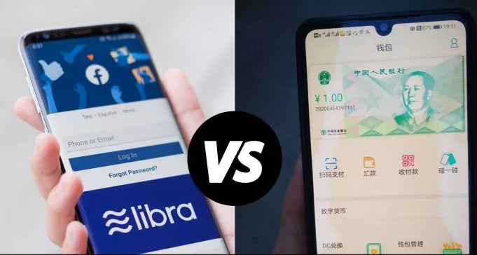
Libra vs. DCEP
The Libra Association said its libra would not be a single currency that was backed by a basket of national currency but would now be a model of numerous individual fiat-pegged currencies.
While the original model was akin to a disruptive implementation of John Maynard Keynes’ original concept for a global basket currency (which he called a “bancor”), this model seems more to position libra to help existing central banks digitize their currencies.
China, meanwhile, steamed forward with its digital currency and blockchain plans. Screenshots of an app from the Agricultural Bank of China show how the DCEP (Digital Currency Electronic Payment) is currently being tested, giving us insight into functionality, geographies and players involved.
China also announced the 71 members of its National Blockchain Council and went live with its Blockchain Service Network. The BSN in particular has potential significance on a world scale as China tries to build and control a key piece of global digital infrastructure.
Notes:
https://www.coindesk.com/libra-vs-dcep-the-battle-for-the-future-of-money-heats-up
The Chinese central bank assembled a task force to study a potential national virtual currency in 2014. Approved by the State Council, PBoC invited major state-owned commercial banks and other influential institutions to design a system for the digital yuan in 2017.

Slide 10









完
Hindi
Traditional Chinese
Thai
Gracias
Russian
Thank You
Spanish
Obrigado
English
Brazilian Portuguese
Arabic
Danke
Grazie
German
Italian
Simplified Chinese
Merci
French
Japanese
Korean
Notes:
10

